Slide 1
Testing Whether Text and Email Contacts Improve Response in a Large ABS Mixed-Mode Study
Joint Statistical Meetings 2024
08.07.2024
Martha McRoy, Leah Christian, Zoe Slowinski, Christopher Hansen

Slide 2
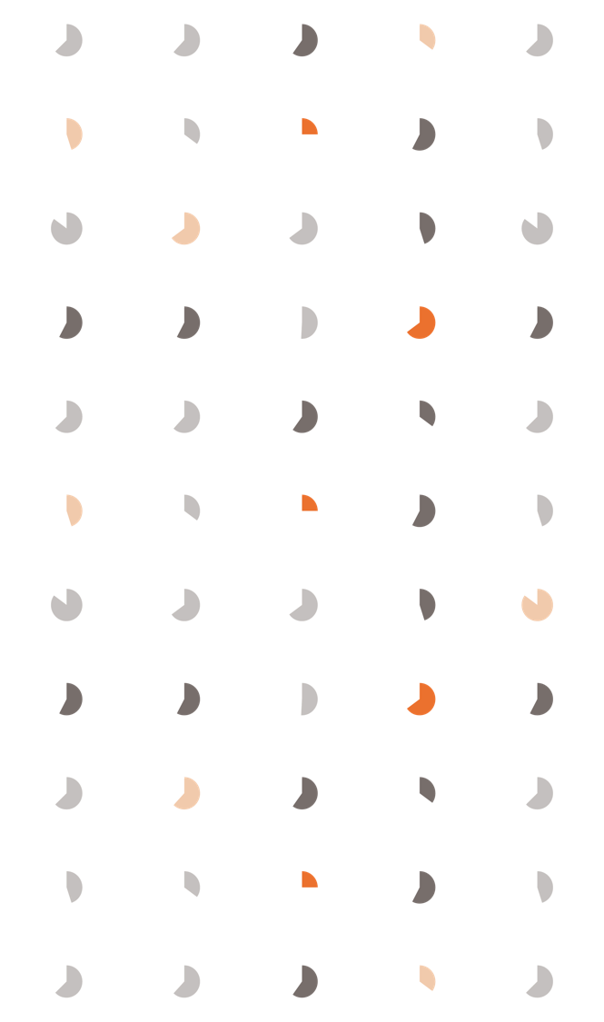
Agenda
01 | National Survey of Fishing, Hunting, & Wildlife-Associated Recreation
02 | Wave 2: Early or Late Text Reminder
03 | Wave 3: Text, Email, or Postcard Reminders
04 | Conclusions
Notes:
I’m going to start by giving some background on the study our experiments were conducted on. I’ll then touch on our Wave 2 experiments where we tested sending an early versus late text reminder. Next, in the Wave 3 experiments, I’ll share the findings of using text, email, or postcard reminders. Finally, I’ll go over some conclusions from this work.

Slide 3
National Survey of Fishing, Hunting, & Wildlife-Associated Recreation
Notes:
All these experiments were conducted on the National Survey of Fishing, Hunting, and Wildlife-Associated Recreation.

Slide 4
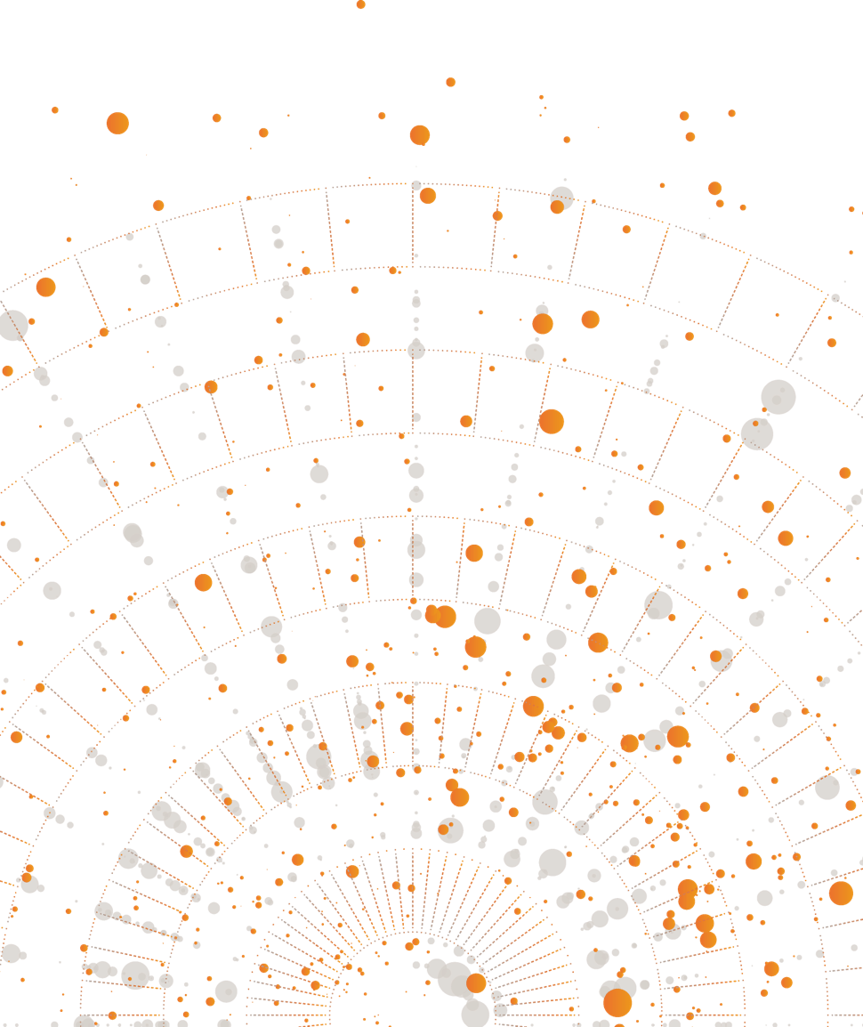
FHWAR : BACKGROUND
2022 National Survey of Fishing, Hunting, & Wildlife-Associated Recreation
Nationally representative, longitudinal, mixed-mode (web, phone, paper) survey
Used to create estimates of participation and expenditure in fishing, hunting, and wildlife watching activities
Design included a screener instrument to identify those who participate in fishing, hunting, and wildlife watching activities and three waves of surveys
Has traditionally used mail outreach
Notes:
The National Survey of Fishing, Hunting, & Wildlife-Associated Recreation is coordinated by the U.S. Fish and Wildlife Service and provides information on individuals involved in fishing, hunting, and other wildlife recreation. A survey screener was used to identify those who participate in such activities, and eligible participants are invited to participate in three survey waves.
Importantly, this survey has traditionally used only mail outreach and contacting.

Slide 5
FHWAR : EXPERIMENTAL DESIGN
 | WAVE 2 |  | WAVE 3
Experiment | Texting |  | Email & Texting
Sequencing | Text invite |  | Text/email invite
 | Early text reminder |  | # of text/email/postcard reminders
 | Late text reminder
Time text messages sent | Morning |  | --
 | Afternoon |  | --
Text messages sent via Twilio
Notes:
Our experiments were conducted across different waves of the survey. There were two separate experiments within Wave 2 of the Fishing Survey. We experimented with sequencing of text contacts with mail contacts, including a text invitation as well as a text reminder early in the field period versus a text reminder late in the field period. In Wave 2 we also experimented with time of day for sending texts where some respondents received their reminder text in the morning while others received it in the evening.
In Wave 3, we experimented with text and email invites, and the number of text and email reminders.

Slide 6
FHWAR : EXPERIMENTAL DESIGN
Sample members stratified by whether they participated in the prior wave from a text
Cooperative Respondents
Respondents who completed the prior wave after receiving a text
Other Respondents
All other sample members, whether they completed the prior wave or not
Notes:
In both waves, we stratified sample members by whether they responded to the prior wave from a text message. We call “Cooperative Respondents” those who completed the prior wave after receiving a text, and “Other Respondents” are all other sample members, whether they completed the prior wave or not.
I’ll explain more why we chose to do this on the next slides.

Slide 7
FHWAR : outcome measures
We assessed the effectiveness of texting and email contact over several outcome measures.
Completion Rates
Cumulative and final completion rates
Completion rates by mode
Response Speed
Number of days between the 1st contact date and the completion date
Data Quality
Web response time
Web and paper item nonresponse rates
Sample Representation
Sample composition across conditions for demographics and selected survey variables
Notes:
In terms of outcome measures, there are several ways to assess the effectiveness of text and email contacting.
In the Fishing Survey, we looked at cumulative and final completion rates as well as completion rates by mode; we looked at response speed, so the number of days between first contact and the date of survey completion. We looked at indicators of data quality, including web response times and item nonresponse rates by web and paper. We also looked at sample composition by key demographic characteristics.

Slide 8
Wave 2
Notes:
With these outcome measures in mind, on the next slides I’ll share our Wave 2 findings.

Slide 9




FHWAR wave 2 : EXPERIMENTAL DESIGN cooperative respondents
Sequencing Treatments Among Cooperative (Text Friendly) Respondents
Early Text Reminder
Text Invitation
Letter Invitation
Early Text Reminder
Postcard Reminder
Postcard Reminder
PAPI Mailing
Late Text Reminder
Text Invitation
Letter Invitation
Postcard Reminder
Late Text Reminder
Postcard Reminder
PAPI Mailing
Notes:
Here we show the sequencing of text, mail, and postcard contacting for our two different “cooperative respondent” (or “text friendly”) treatment groups. The “white” boxes of letters and postcards represents original Fishing contacting protocol – a letter invitation, post card reminders, and PAPI mailing. The grey, orange, and purple boxes represent the TEXT contacts that were added.
The reason we stratified by “Cooperative Respondents,” and “Other Respondents,” is that “Cooperative Respondents” had shown a favorable response to text in the prior wave. Because they were “text friendly,” we wanted both treatment groups to receive a text invitation, which you can see all the way on the left.
The key difference here between the “Cooperative Respondents” treatment groups is the “early-in-field-period” text reminder in orange and the “late-in-field-period reminder” in purple.

Slide 10
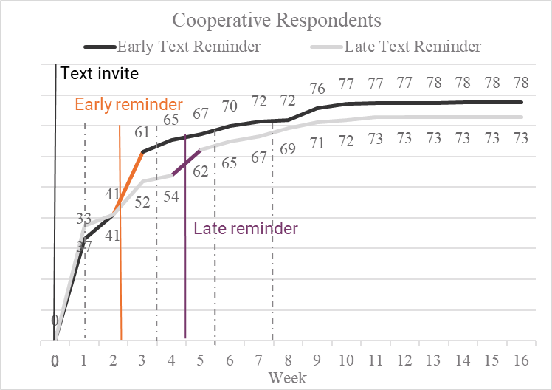
FHWAR wave 2 : completion rates cooperative respondents
The early text reminder was somewhat more effective than the late reminder, especially in boosting completion early in the field period.
Text Invitation
Early Text Reminder
Late Text Reminder
Early Text Reminder
Late Text Reminder
Mail Contact Attempt
Notes:
On this slide we show completion rates of our two treatments groups on the Y-axis by week of data collection on the X-axis. What we see here is that the early text reminder – represented by that bolded orange line -, was somewhat more effective than the late reminder – represented by the bolded purple line - especially boosting completion early in the field period, those weeks 2-3 there.

Slide 11
FHWAR wave 2 : EXPERIMENTAL DESIGN other respondents
Sequencing Treatments Among Other Respondents
Text Invite
Text Invitation
Letter Invitation
Postcard Reminder
Postcard Reminder
PAPI Mailing
Early Text Reminder
Letter Invitation
Early Text Reminder
Postcard Reminder
Postcard Reminder
PAPI Mailing
Late Text Reminder
Letter Invitation
Postcard Reminder
Postcard Reminder
PAPI Mailing
Late Text Reminder
Notes:
On the next slide here we have the sequencing treatments among our *“Other Respondents.” Again, the white boxes represents the traditional mail-only contacting strategy for the Fishing survey. The grey, orange, and purple boxes represent the TEXT contacts that were added.
This design allows us to see the effects of a text invitation only – in the first row treatment group – compared to an early text reminder in the second treatment group and late text reminder in the third treatment group.

Slide 12
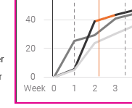
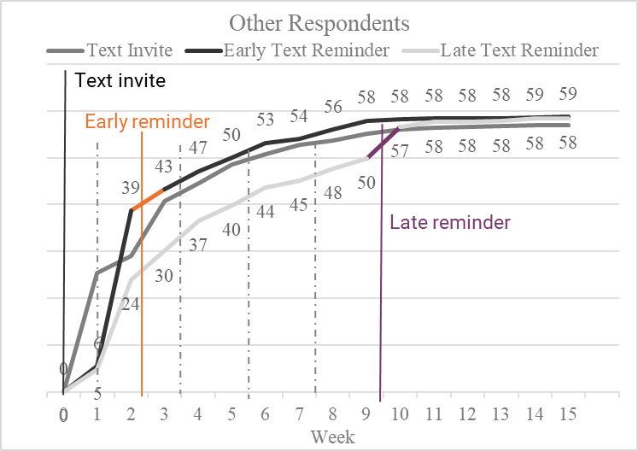
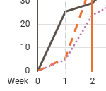
FHWAR wave 2 : completion rates other respondents
Text invitation group saw early boost in completion, early text reminder similarly more effective than late text reminder
Text Invitation
Early Text Reminder
Late Text Reminder
Text Invitation
Early Text Reminder
Late Text Reminder
Mail Contact Attempt
Notes:
Here we have our completion rates by our three “Other Respondents” treatment groups on the Y-axis with weeks of data collection on the X-axis. The two findings I want to point out on this slide is that the text invitation group in GREY saw an early boost in completion during week 1 compared to the other two treatment groups in orange and purple. And then similarly with our “Cooperative Respondents” groups, we saw that the early text reminder was somewhat more effective than the late text reminders – represented by the bolded orange line and bolded purple line, respectively.

Slide 13

FHWAR wave 2 : other findings
Very few significant differences in other outcomes analyzed
Response Speed
The early text reminder among Other Respondents was the most effective at getting sampled members to complete via web as quickly as possible (average 13 days, compared with 18-21 days)
Data Quality
No significant effects of sequencing on web response time or item nonresponse among Cooperative or Other Respondents
Sample Representation
Cooperative Respondents were different demographically than Other respondents, but the sample representation was similar for the experimental groups within each.
Early text reminder saw response speeds of 5 to 8 days shorter for Other Respondents.
Notes:
As I mentioned, in addition to completion rates, we also looked at other outcome measures. There weren’t many significant differences in other outcomes analyzed. One that I *will mention is that the early text reminder among Other Respondents was associated with significantly shorter response speeds, with the early text reminder group responding 5-to-8 days sooner than other treatment groups.
In terms of the data quality indicators of response time and item nonresponse, there were no significant differences between treatment groups among Cooperative or Other Respondents.
And then for sample representation, there were differences in demographics between Cooperative and Other respondents; *however, the sample representation was similar for the experimental groups within each.
I also did want to mention that the time of day the text messages were sent did not affect any of the outcome measures examined, so we chose not to focus on that here today.

Slide 14
Wave 3
Notes:
Now for our Wave 3 experiments.

Slide 15

FHWAR WAVE 3 : EXPERIMENTAL DESIGN COOPERATIVE RESPONDENTS
Sequencing Treatments Among Cooperative (Text Friendly) Respondents
One Text Reminder
Text Invitation
Letter Invitation
Text Reminder
Postcard Reminder
Postcard Reminder
PAPI Mailing
Two Text Reminders
Text Invitation
Letter Invitation
Text Reminder
Postcard Reminder
Text Reminder
PAPI Mailing
One Email Reminder
Text Invitation
Letter Invitation
Email Reminder
Postcard Reminder
Postcard Reminder
PAPI Mailing
Notes:
Here we show the sequencing of contacts for Wave 3 “cooperative respondent” (or “text friendly”) treatment groups. Again, the “white” boxes represent the original contacting protocol. The grey, orange, and blue boxes represents the NEW TEXT AND EMAIL contacts we added in this wave.
All COOPERATIVE RESPONDENTS received a text invitation (as these were all text friendly respondents)
They differ in the type of reminders sent.
For the first group pictured – the One Text Reminder group - we added a text reminder right after the letter mailing.
For the second group – the Two Text Reminders group - we added the same text reminder and also replaced the last postcard reminder with a text reminder.
For the third group – the One Email Reminder group - we inserted an email reminder (instead of a text reminder)
This design allowed us to compare the effectiveness of adding 1 vs. 2 text reminders, as well a text vs. email reminder

Slide 16
FHWAR wave 3 : completion rates cooperative respondents
One text reminder was more effective than two text reminders.
One Text Reminder
Text Invitation
Email Reminder
Two Text Reminders
One Email Reminder
Mail contact attempt
Notes:
Here you can see the completion rates among these Cooperative Respondents. Each treatment group is a different style line. And the contacts are shown by vertical lines, with the dotted gray lines signifying mail contacts.
We found, somewhat surprisingly, that one text reminder (the solid black line) was more effective than two text reminders (the orange dashed line)

Slide 17
FHWAR WAVE 3 : EXPERIMENTAL DESIGN OTHER RESPONDENTS
Sequencing Treatments Among Other Respondents
Email Invite and Email Reminder
Email Invitation
Letter Invitation
Email Reminder
Postcard Reminder
Postcard Reminder
PAPI Mailing
Email Invite and Text Reminder
Email Invitation
Letter Invitation
Text Reminder
Postcard Reminder
Postcard Reminder
PAPI Mailing
Notes:
Now we’ll look at our other type of respondent - the “Other” Respondents (or those who were not text-friendly). For this group, we sent email invitations rather than text message invitations.
For the first treatment group pictured – the Email Invite and Email Reminder group – we added an email invitation before the letter invitation, and added an email reminder.
For the second group – The Email Invite and Text Reminder group - we tried a text reminder instead of an email reminder
==
All emails we’re going to talk about today are high quality emails – the respondent provided the same email for screening and incentive payment in a prior wave.
We had a sixth experimental condition that we are not going to focus on today – this was a version of the Email Invite and Text Reminder condition using low quality email addresses, emails which did not match. We did this to see if the quality of the email address had an impact. We did not see any interesting differences so we’re not including it today.

Slide 18
FHWAR wave 3 : completion rates Other respondents
There was no real difference in completion rates after receiving an email or text reminder.
Email Invitation
Text Reminder
Email Reminder
Email reminder
Text reminder
Mail contact attempt
Notes:
Here you can see the completion rates among the Other Respondents. We did not see a real difference in completion rate between the group that got an email reminder (the green dashed line) and the group that got a text reminder (the dotted orange line)

Slide 19
FHWAR WAVE 3 : COMPLETION RATES
Texting encouraged a higher completion rate via smartphone, while email led to a mix of smartphone and other web completes.
Cooperative Respondents
Other Respondents
Notes:
While we didn’t see much in the way of a difference in completion rates overall, we did find something interesting when looking at the mode of completion.
Here you can see web respondents for each of our treatment groups. The dark green represents the proportion that completed via smartphone. The light green represents those that completed via another web mode.
What we found is that those who received text messages were more likely to complete the web survey via smartphone. For other respondents (those who got email invitations), we see a more balanced mix of smartphone and other web completes.
However it is also worth noting that the Other Respondents were by definition not as text-friendly, so that could be part of what is going on here.

Slide 20
FHWAR wave 3 : other findings
Few significant differences in other outcomes analyzed
Response Time
For Other Respondents, text reminders led to earlier completion than emails (13 vs. 15 days). However, emails went out 11 days later than texts, which may have impacted results.
No significant differences for Cooperative Respondents.
Data Quality
For Cooperative Respondents, those who received only one reminder text had quicker web response times than those who received two text reminders (10 vs. 11 min). No significant differences for Other Respondents.
No significant differences for item nonresponse.
Sample Representation
Minimal demographic differences which did not affect survey results.
Notes:
Beyond completion rates, we found little in terms of significant differences for the other outcome measures.
Response Time:
For Other Respondents, text reminders led to earlier completion than emails (13 vs. 15 days). However, emails went out 11 days later than texts, which may have impacted results.
No significant differences for Cooperative Respondents (our Text-friendly respondents).
Data Quality
For Cooperative Respondents, those who received only one reminder text had quicker web response times than those who received two text reminders (10 vs. 11 min).
No significant differences for Other Respondents.
No significant differences for item nonresponse.
Sample Representation
Minimal demographic differences which did not affect survey results.

Slide 21
Conclusions
Notes:
Some general conclusions of our experiments on the fishing survey.

Slide 22
FHWAR : CONCLUSIONS
Both texting and emailing are likely to play a key role in contact strategies for mixed-mode surveys, especially those with short field periods
Text Sequencing
Text reminders may be more effective than text invites
An early text reminder was more effective than a late text reminder, shortening response time and raising completion early
Time of Day
Sending the text in the morning vs. afternoon did not have a significant impact on the outcome measures analyzed
Text vs. Postcard Reminders
Sending 1 reminder text and 2 postcards resulted in higher completion rates than 2 text reminders and only 1 postcard
Text Reminders
Sending text reminders was not negatively associated with data quality or sample representation
Text vs. Email Invitations
Text invitations resulted in more completes via smartphone
Notes:
Looking across these experiments, we see that both texting and emailing are likely to play a key role in contact strategies for mixed-mode surveys, especially those with short field periods.
Text Sequencing:
Text reminders may be more effective than text invites
An early text reminder was more effective than a late text reminder, shortening response time and raising completion early
Time of Day
We found time of day did not have a significant impact on the outcome measures
When comparing Text & Postcard Reminders, we saw that sending 1 reminder text and 2 reminder postcards resulted in higher completion rates than 2 text reminders and only 1 postcard
When comparing Email & Text Reminders, we did not see a significant difference from using email or text reminders following an initial email invitation.
When comparing Text & Email Invitations, we found that text invitations resulted in more completes via smartphone (as opposed to other web completes).

Slide 23
Thank you.
Martha McRoy
Senior Research Methodologist I
McRoy-Martha@norc.org

Slide 24
Supplemental Slides

Slide 25






FHWAR WAVE 3 : EXPERIMENTAL DESIGN OTHER RESPONDENTS
Sequencing Treatments Among Other Respondents
Email Invite and Email Reminder
High Quality Email (HQ)
HQ Email Invitation
Letter Invitation
HQ Email Reminder
Postcard Reminder
Postcard Reminder
PAPI Mailing
Email Invite and Text Reminder
High Quality Email (HQ)
HQ Email Invitation
Letter Invitation
Text Reminder
Postcard Reminder
Postcard Reminder
PAPI Mailing
Email Invite and Text Reminder
Low Quality Email (LQ)
LQ Email Invitation
Letter Invitation
Text Reminder
Postcard Reminder
Postcard Reminder
PAPI Mailing
High quality email: respondent provided the same email for contact and incentive payment Low quality email: respondent did not provide the same email for contact and incentive payment.
Email Invite and Email Reminder, High Quality Email (HQ)
Email (HQ) Invitation
Letter Invitation
Email (HQ) Reminder
Postcard Reminder
Postcard Reminder
PAPI Mailing
Email Invite and Text Reminder, High Quality Email (HQ)
Email (HQ) Invitation
Letter Invitation
Text Reminder
Postcard Reminder
Text Reminder
PAPI Mailing
Email Invite and Text Reminder, Low Quality Email (LQ)
Email (LQ) Invitation
Letter Invitation
Text Reminder
Postcard Reminder
Postcard Reminder
PAPI Mailing
Notes:
The Other Respondents (Those who were not text-friendly) received email invitations rather than text message invitations.
Before I describe these 3 groups, I want to just share a note about the quality of email addresses.
In the Wave 3 experiments, we further tested whether the quality of an email address had an impact.
To do this, we first reviewed the email addresses provided by respondents and separated them into high quality emails and low quality emails.
A high quality email was one the respondent provided both during screening and later for incentive payment.
Low quality were all others. Two of our 3 groups here used high quality emails.
So with that, I will describe the treatment groups --
For the first treatment group pictured – the High Quality Email Invite and Email Reminder group – we added an email invitation before the letter invitation, and added an email reminder.
For the second and third treatment groups pictured – the Email Invite and Text Reminder groups – we added the email invitation and a text reminder (instead of the email reminder).
The only difference between groups 2 and 3 here is that group 2 is a high quality email and the last one is a low quality email.
This design allowed us to compare the effectiveness text reminders vs. email reminders, and whether the quality of the email address matters.

Slide 26
FHWAR WAVE 3 : COMPLETION RATES
For Cooperative Respondents, one text reminder and two postcards led to a higher completion rate than two text reminders and one postcard.
 | Cooperative Respondents |  |  | Other Respondents
 | One Text Reminder Two Postcard Reminders | Two Text Reminders | One Email Reminder Two Postcard Reminders | Email Invite High Quality Email Email Reminder | Email Invite High Quality Email Text Reminder | Email Invite Low Quality Email Text Reminder
Sample size (Unweighted n) | 934 | 936 | 934 | 1,953 | 1,953 | 708
Completion rate (%) | 84.5 | 75.2 | 79.5 | 82.4 | 80.7 | 78.5
Notes:
So what did we find?
For the cooperative respondents (our text-friendly respondents), we found, somewhat surprisingly, that 1 text reminder and 2 postcards led to a higher completion rate than 2 text reminders and 1 postcard. A difference of about 10 points.
For other respondents (Those that received email invitations), we did not find any statistically significant differences between treatment groups.

Slide 27
FHWAR WAVE 3 : COMPLETION RATES
Texting encouraged a higher completion rate via smartphone, while email led to a mix of smartphone and other web completes.
Completion Rate (%) by Mode | Cooperative Respondents |  |  | Other Respondents
 | One Text Reminder Two Postcard Reminders | Two Text Reminders | One Email Reminder Two Postcard Reminders | Email Invite High Quality Email Email Reminder | Email Invite High Quality Email Text Reminder | Email Invite Low Quality Email Text Reminder
Web | 82.1 | 73.6 | 77.6 | 81.4 | 78.4 | 77.2
Smartphone | 71.8 | 64.6 | 67.3 | 37.2 | 41.9 | 40.3
Other Web | 10.3 | 9.1 | 10.3 | 44.2 | 36.6 | 36.9
Paper | 2.0 | 1.1 | 0.7 | 0.9 | 2.2 | 1.2
Phone | 0.4 | 0.4 | 1.2 | 0.1 | 0.0 | 0.1
Notes:
We also looked at the completion rates by mode.
What we found is that those who received text messages were more likely to complete the web survey via smartphone. You can see the highlighted difference here – Cooperative Respondents (who got a text message invitation) had much higher completion rates on smartphones than for other web modes. For other respondents (those who got email invitations), we see a more balanced mix of smartphone and other web completes.
However it is also worth noting that the Other Respondents were by definition not as text-friendly, so that could be part of what is going on here.

